Slide 1
Parallel Architecture and Execution
Lecture 2
January 10, 2024

Slide 2
A Parallel System
Combination of
Algorithm
Parallel architecture

Slide 3
Saturation – Example 1
#Processes | Time (sec) | Speedup | Efficiency
1 | 0.025 | 1 | 1.00
2 | 0.013 | 1.9 | 0.95
4 | 0.010 | 2.5 | 0.63
8 | 0.009 | 2.8 | 0.35
12 | 0.007 | 3.6 | 0.30

Slide 4
Saturation – Example 2

Slide 5
Saturation – Example 3
Source: GGKK Chapter 5

Slide 6
Efficiency (Adding numbers)
Source: GGKK Chapter 5

Slide 7
Limitations of Parallelization
Overhead
  E.g. communication
Over-decomposition
  Work per process/core
Idling
  Load imbalance
  Synchronization
  Serialization

Slide 8
Execution Profile
Source: GGKK Chapter 5

Slide 9
Performance
Sequential
  Input size
Parallel
  Input size
  Number of processing elements
  Communication speed
  …

Slide 10
Parallelization
P
Speedup
Efficiency

Slide 11
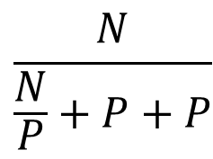
Sum of Numbers
S
=
$$\frac{N}{\frac{N}{P}+P+P}$$
Naïve approach: Many-to-one

Slide 12
Parallel Sum (Optimized)
Source: GGKK Chapter 5

Slide 13
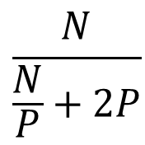
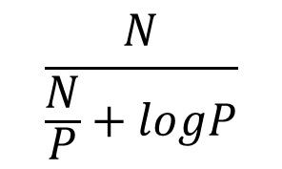
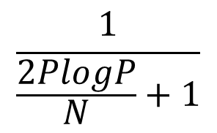
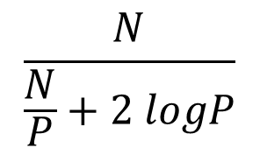
Sum of Numbers Speedup (Optimized)
S₁
=
$$\frac{N}{\frac{N}{P}+2P}$$
E₁ = ?
$$\frac{N}{\frac{N}{P}+2 logP}$$
$$\frac{1}{\frac{2PlogP}{N}+1}$$
S₂
=
$$\frac{N}{\frac{N}{P}+logP}$$
E₂ =

Slide 14
Efficiency (Adding numbers)
Homework: Analyze the measured efficiency based on your derivation
Source: GGKK Chapter 5

Slide 15
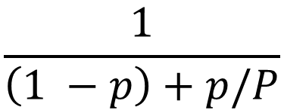
A Limitation of Parallel Computing
Fraction of code that is parallelizable
Speedup S =
$$\frac{1}{\left(1 −p\right)+p/P}$$
Amdahl’s Law

Slide 16
Parallel Architecture

Slide 17
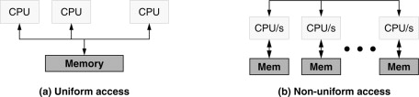
System Components
Processor
Memory
Network
Storage
NUMA
Source: https://www.sciencedirect.com/topics/computer-science/non-uniform-memory-access

Slide 18
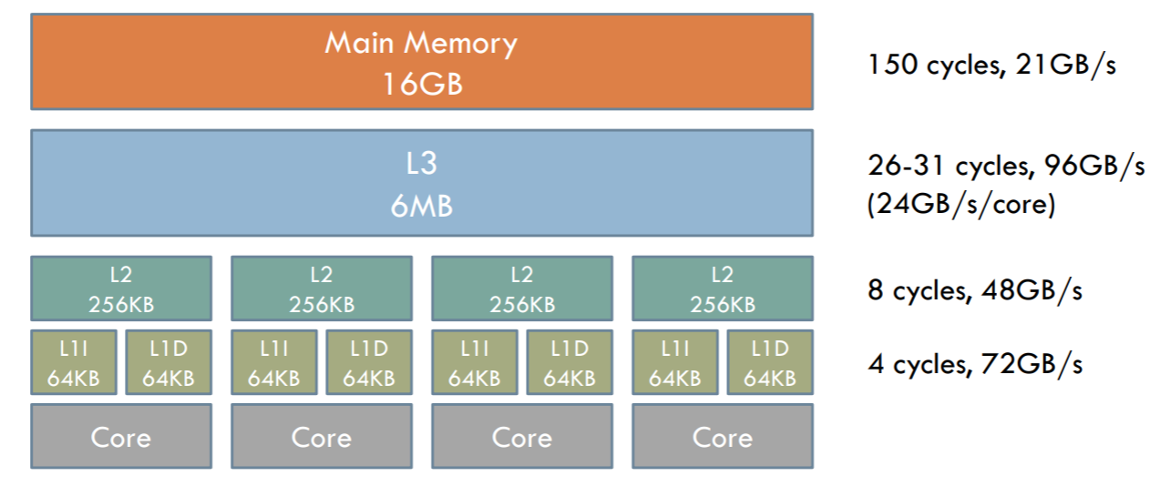
Memory Access Times
Source: MIT CSAIL

Slide 19
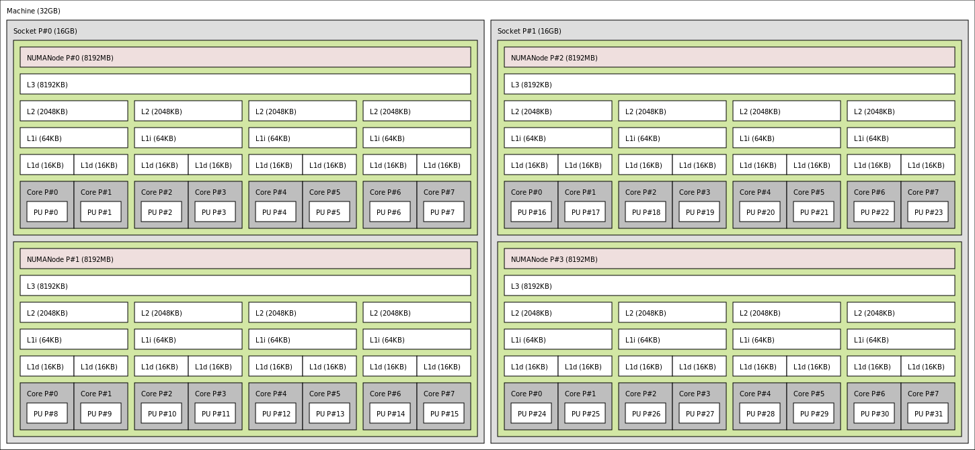
NUMA Nodes
Utility: lstopo
AMD Bulldozer Memory Topology (Source: Wikipedia)

Slide 20
Effective Memory Access Times

Slide 21
Processor vs. Memory
“While clock rates of high-end processors have increased at roughly 40% per year over the last decade, DRAM access times have only improved at the rate of roughly 10% per year over this interval.”
- Introduction to Parallel Computing by Ananth Grama et al. (GGKK)

Slide 22
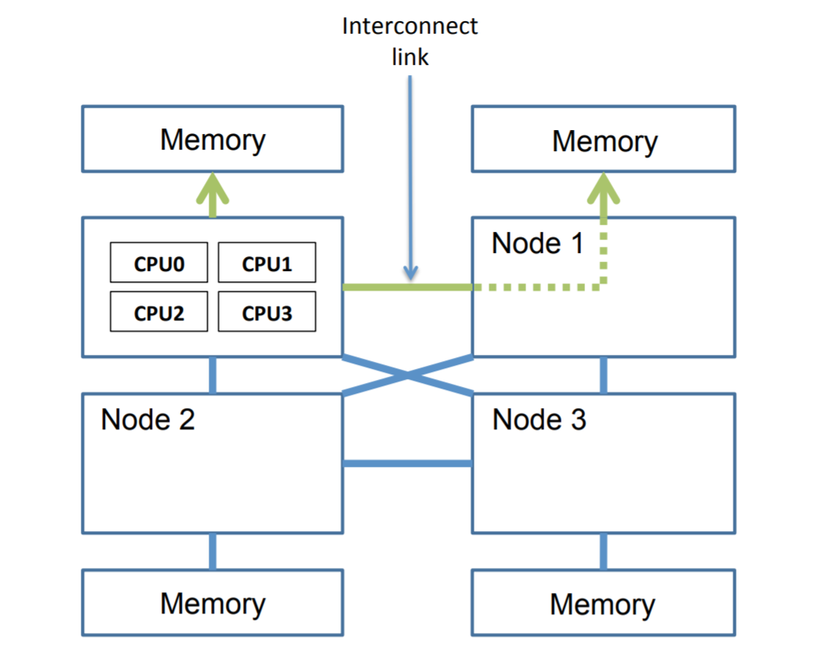
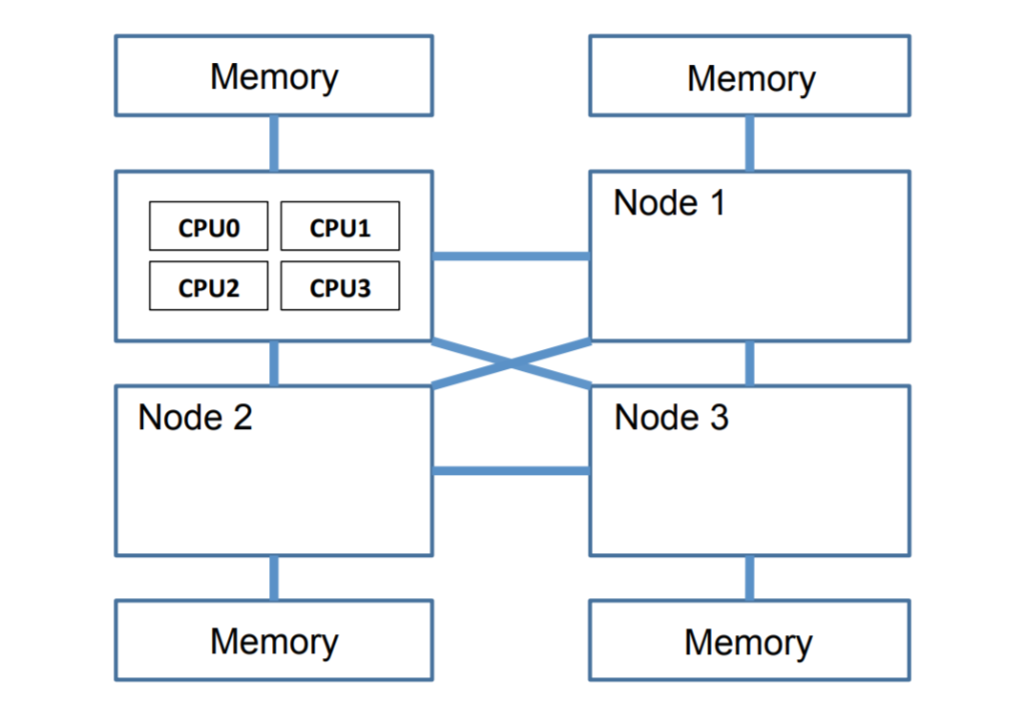
Memory Placement
Lepers et al., “Thread and Memory Placement on NUMA Systems: Asymmetry Matters”, USENIX ATC 2015.

Slide 23
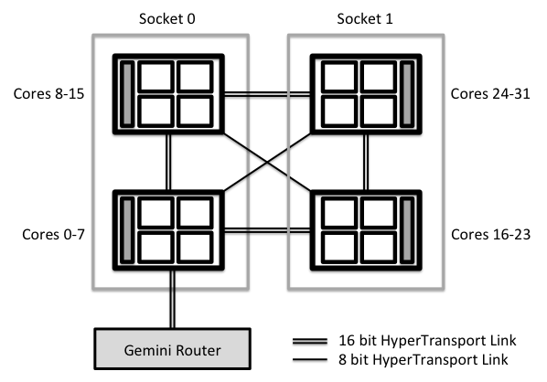
Connect Multiple Compute Nodes
Source: hector.ac.uk
Notes:
With large scale machines, memory may be arranged into banks that incur a different cost to access depending on the “distance” from the processor. For example, there might be a bank of memory assigned to each CPU or a bank of memory very suitable for DMA near device cards.

Slide 24
Shared Memory
Shared address space
Time taken to access certain memory words is longer (NUMA)
Programming paradigms – Pthreads, OpenMP
Need to worry about concurrent access
Notes:
The term shared-memory computer is historically used for architectures in which the memory is physically shared among various processors, i.e., each processor has equal access to any memory segment. This is identical to the UMA model we just discussed. A distributed-memory shared-address-space computer is identical to a NUMA machine.

Slide 25
Cluster of Compute Nodes

Slide 26
Message Passing
Distinct address space per process
Multiple processing nodes
Basic operations are send and receive

Slide 27
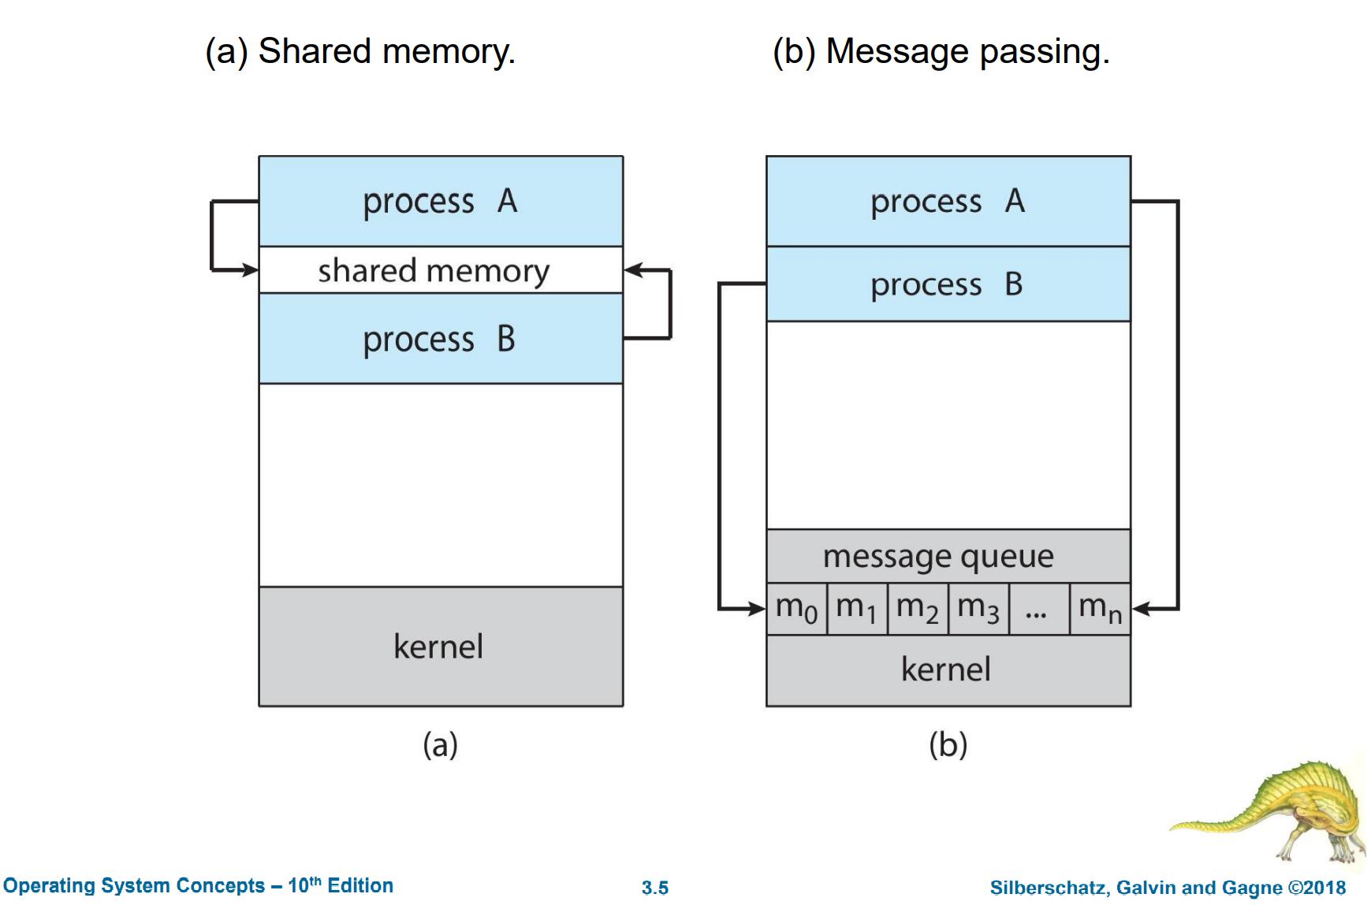
Interprocess Communication

Slide 28
Our Parallel World
Core
Process
Memory
Distributed memory programming
Distinct address space
Explicit communication
Notes:
How does OS launch processes?

Slide 29
Distinct Process Address Space
Process 0
Process 1
x = 1, y = 2
. . .
x++
. . .
print x, y
x = 10, y = 20
. . .
x++
. . .
print x, y
2, 2
11, 20

Slide 30
Distinct Process Address Space
Process 0
Process 1
x = 1, y = 2
. . .
x++; y++
. . .
print x, y
x = 1, y = 2
. . .
y++
. . .
print x, y
2, 3
1, 3

Slide 31
Our Parallel World
Core
Process
NO centralized server/master
Notes:
How does OS launch processes?

Slide 32
Message Passing Interface

Slide 33
Message Passing Interface (MPI)
Efforts began in 1991 by Jack Dongarra, Tony Hey, and David W. Walker.
Standard for message passing in a distributed memory environment
MPI Forum in 1993
  Version 1.0: 1994
  Version 2.0: 1997
  Version 3.0: 2012
  Version 4.0: 2020 (draft)
Notes:
Jack Dongarra, put forward a preliminary draft proposal, "MPI1", in November 1992.
MPI-1 (1994), presented at SC’93
–
Basic point-to-point communication, collectives, datatypes, etc
§
MPI-2 (1997)
–
Added parallel I/O, Remote Memory Access (one-sided operations), dynamic processes,
thread support, C++ bindings, ...
§
----
Unchanged for 10 years
----
§
MPI-2.1 (2008)
–
Minor clarifications and bug fixes to MPI-2
§
MPI-2.2 (2009)
–
Small updates and additions to MPI 2.1
§
MPI-3.0 (2012)
–
Major new features and additions to MPI (nonblocking collectives, neighborhood
collectives, improved RMA, tools interface, Fortran 2008 bindings, etc.)
§
MPI-3.1 (2015)
–
Small updates to MPI 3.0

Slide 34
MPI Implementations
“The MPI standard includes point-to-point message-passing, collective communications, group and communicator concepts, process topologies, environmental management, process creation and management, one-sided communications, extended collective operations, external interfaces, I/O, some miscellaneous topics, and a profiling interface.” – MPI report
MPICH (ANL)
MVAPICH (OSU)
OpenMPI
Intel MPI
Cray MPI

Slide 35
Programming
Shell scripts (e.g. bash)
ssh basics
  E.g. ssh –X
  …
Mostly in C/C++
Compilation, Makefiles, ...
Linux environment variables
  PATH
  LD_LIBRARY_PATH
  …

Slide 36
MPI Installation – Laptop
Linux or Linux VM on Windows
  apt/snap/yum/brew
Windows
  No support
https://www.mpich.org/documentation/guides/

Slide 37
MPI
Standard for message passing
Explicit communications
Medium programming complexity
Requires communication scope

Slide 38
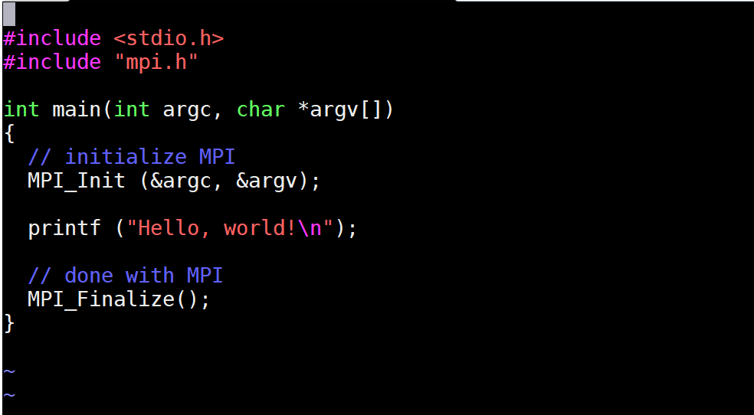
Simple MPI Code
Notes:
As many parallel processes will run this, that many Hello world

Slide 39
MPI Code Execution Steps
Compile
  mpicc -o program.x program.c
Execute
  mpirun -np 1 ./program.x (mpiexec -np 1 ./program.x)
    Runs 1 process on the launch/login node
  mpirun -np 6 ./program.x
    Runs 6 processes on the launch/login node

Slide 40
Execution
MPI process
MPI process
1 node, processes per node (ppn)=2
mpiexec –n <number of processes> ./exe

Slide 41
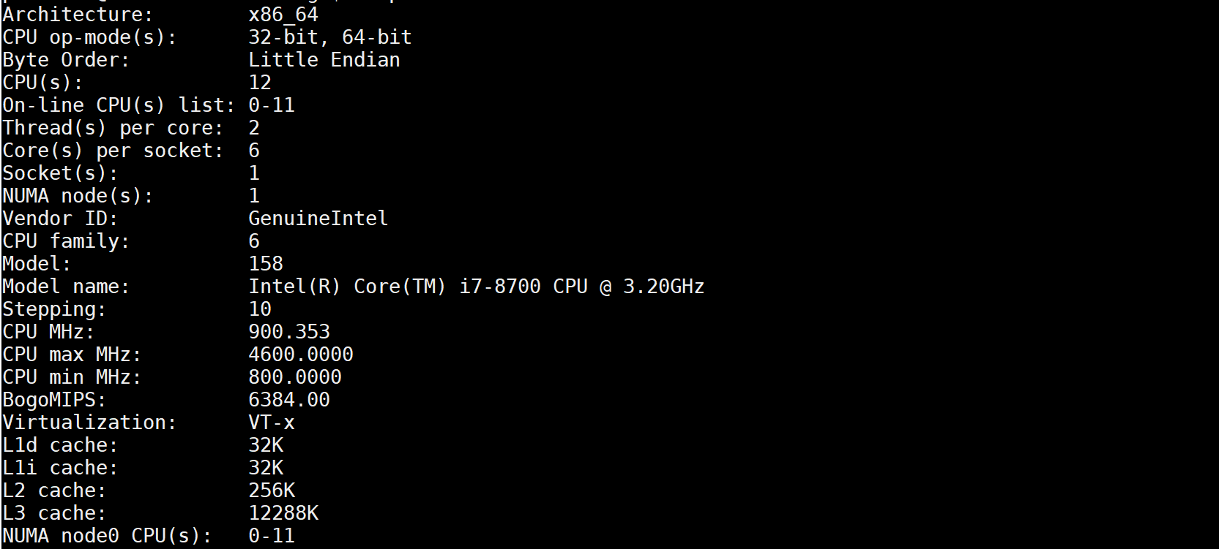

csews*
lscpu

Slide 42
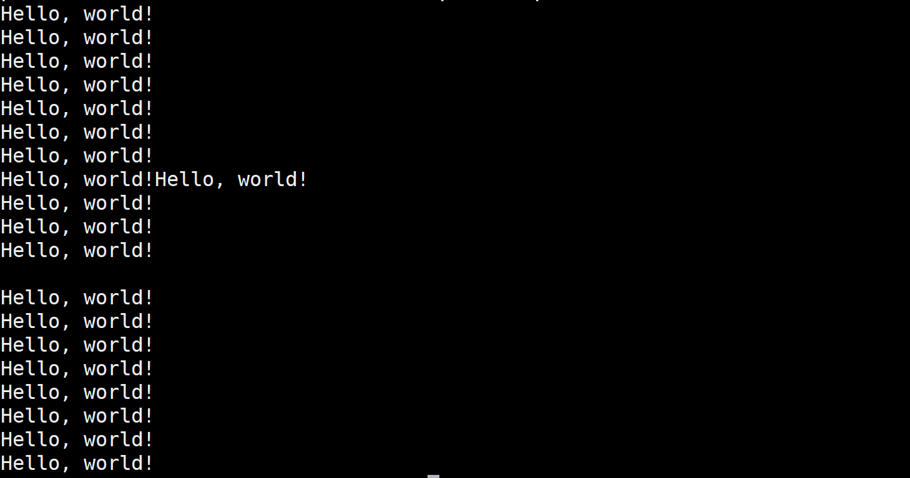
Output – Hello World
mpirun –np 20 ./program.x

Slide 43
Multiple Processes
Core
Process
Memory
0
2
4
6
1
3
5
7
Node 1
Node 2
Node 3
Node 4
<hostfile>
Host1:2
Host2:2
…
mpiexec –np 8 –f hostfile ./program.x
Run examples/cpi (mpirun –np 8 <path to examples/cpi>)

Slide 44
MPI Code Execution Options
Same host
mpirun -np 6 ./program.x
Multiple hosts
mpirun -np 6 –f hostfile ./program.x
Round robin process placement
  mpirun -np 6 –hosts csews1,csews2 ./program.x
Host-wise placement
  mpirun -np 6 –hosts csews1:3,csews2:3 ./program.x

